Slide 1
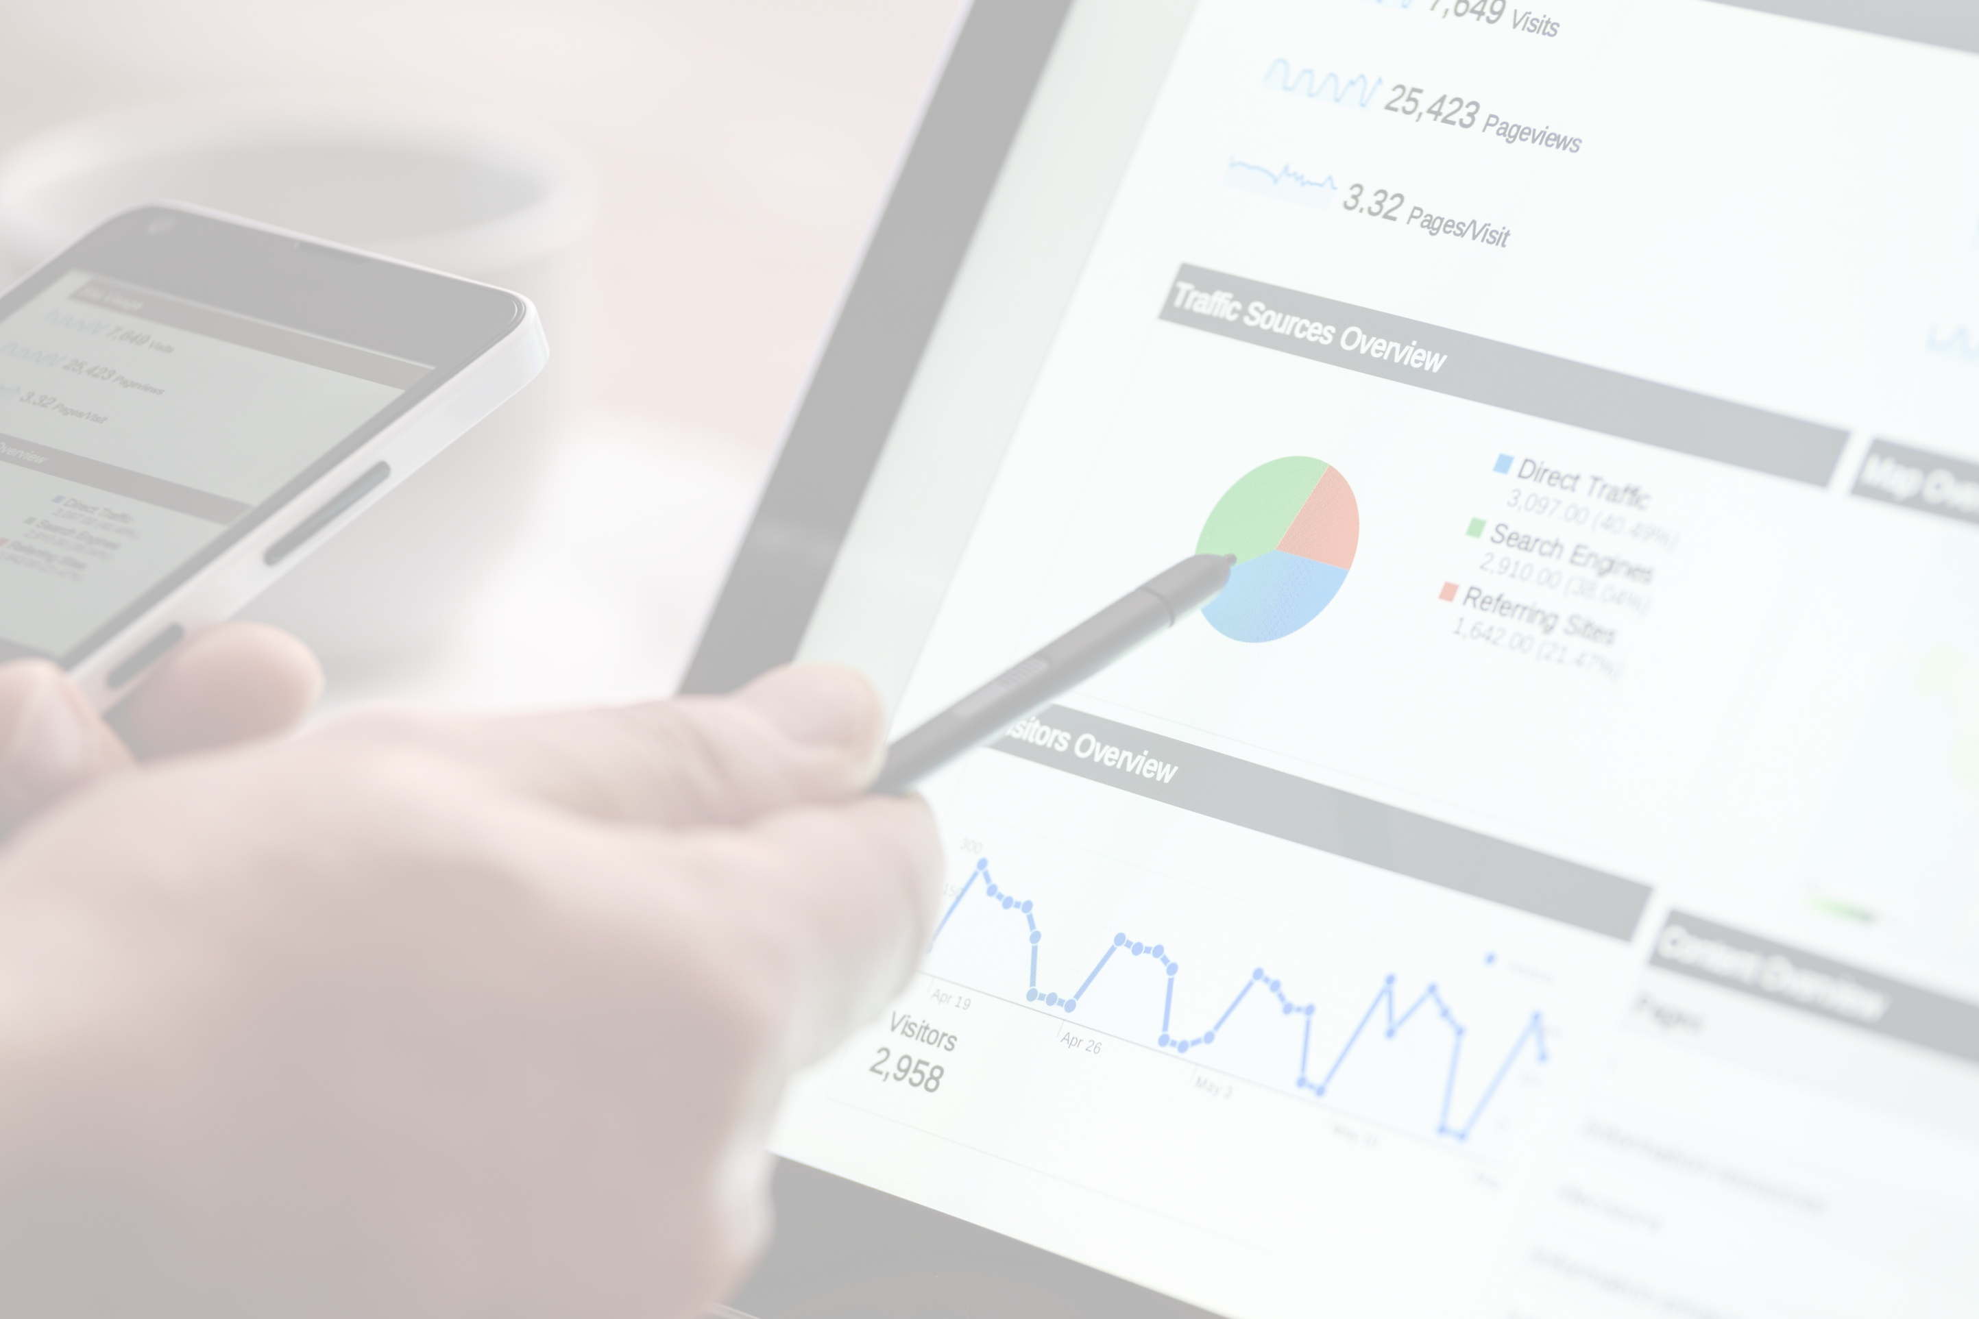
MARKETING WEB ANALYTICS AND INSIGHTS
MKT 6352
GROUP 4:
Joshi, Havi - HXJ220003
Mondkar, Utkarsh Jayant - UXM220000
Parab, Purva Pravin - PXP220024
Patidar, Manasvi - MXP220046
Rane, Manish Nitin - MXR220016
Sathravada, Anusha - AXS220402

Slide 2
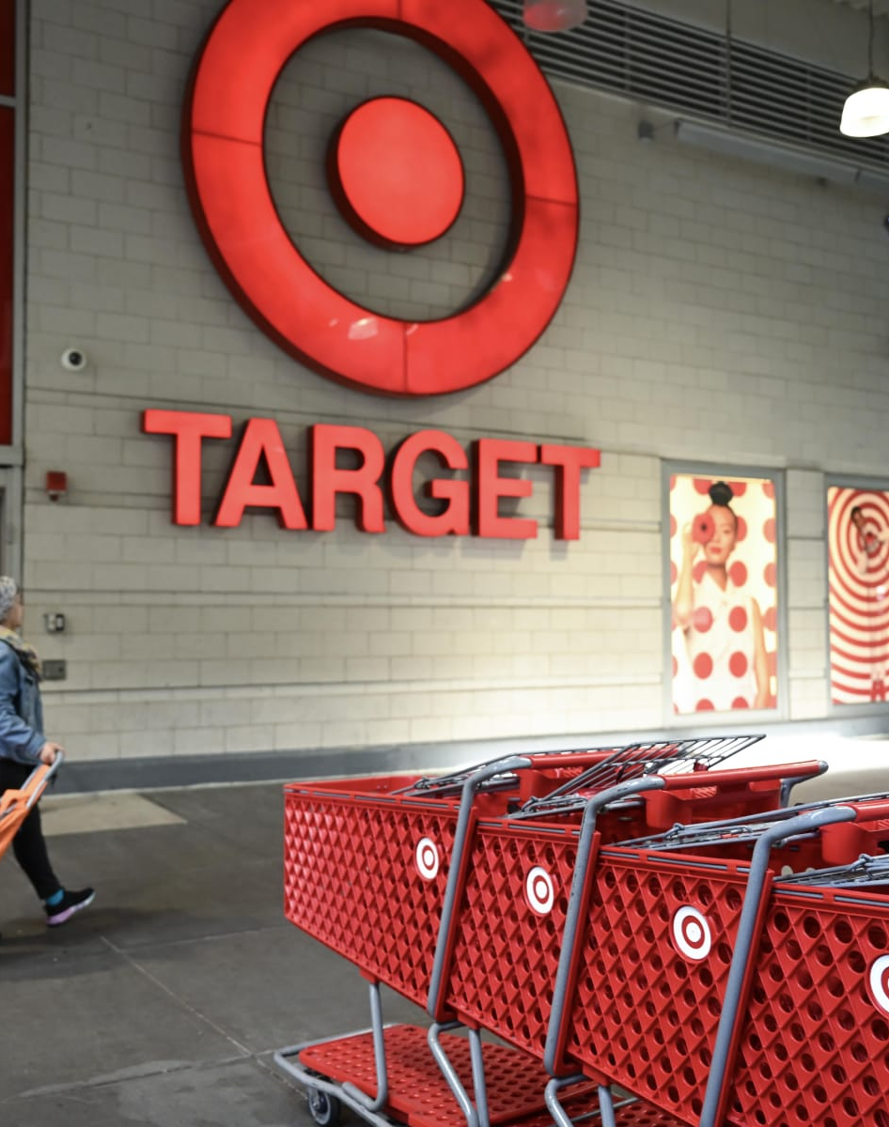
Agenda
Company Overview
Sales strategy
Objectives
Key Performance Indicators
Inferences
Recommendations

Slide 3
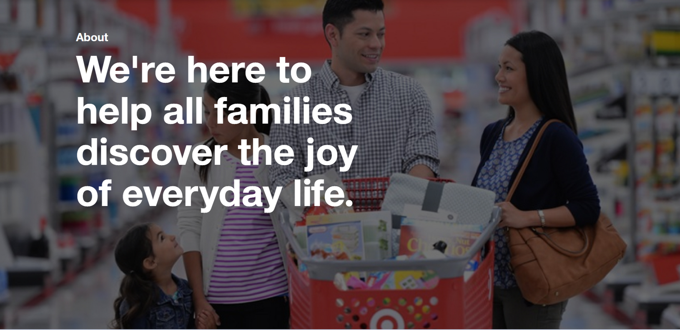
COMPANY OVERVIEW
Target Corporation is a well-established retail chain that operates across the United States, known for its diverse range of products and commitment to quality and style.
Founded in 1902
Target has a rich history of providing customers with a wide array of goods, including clothing, electronics, household essentials, groceries, and more.
Headquarters: Minneapolis, Minnesota
The company operates over 2000 stores and employs more than 400,000 people.

Slide 4




Sales Strategy
Target drives sustained growth by diversifying products, entering new markets, and elevating customer experiences to meet evolving needs.
Target employs advanced analytics to optimize products and provide personalized experiences that resonate with its diverse customer base.
Target focuses on optimizing its sales approach by strategic marketing campaigns, innovative promotions, and a commitment to sustainability.

Slide 5
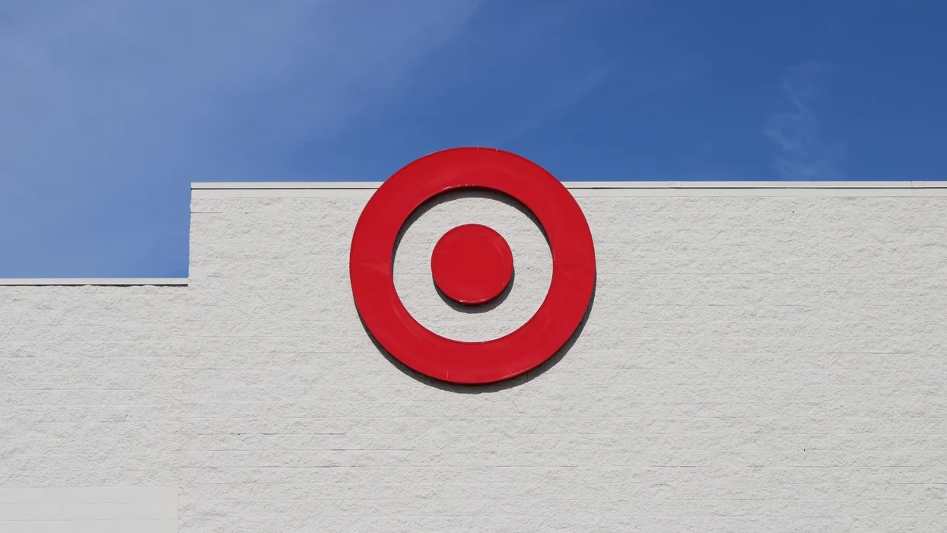
Customer Loyalty and Engagement
TARGET'S OBJECTIVES
Target aims to increase customer loyalty and repeat purchases through improvements to loyalty programs and personalized communication.
Strategies involve extending and marketing the Target Circle loyalty program with exclusive discounts, introducing a feedback system for continual enhancement, leveraging customer data for personalized recommendations, and creating a customer-centric content strategy through informative blog posts and compelling social media content.
These efforts seek to enhance customer connections and encourage higher levels of repeat buying.
KPI used: Bounce Rate

Slide 6
TARGET'S OBJECTIVES
Strategic Conversion
When establishing key performance indicators (KPIs) for an e-commerce store's conversion rate, it's crucial to align them with the overarching business goals.
The conversion rate, representing the percentage of website visitors taking desired actions like making a purchase, is a pivotal metric.
Below are specific, measurable, achievable, relevant, and time-bound (SMART) objectives for these KPIs.
Regularly monitoring and analyzing performance, along with adjusting strategies, is essential to consistently optimize the conversion rate and contribute to the overall success of the e-commerce store.
KPI used: Conversion Rate

Slide 7
Integrated marketing campaign for Revenue Growth
TARGET'S OBJECTIVES
Integrated marketing campaign for Revenue Growth
Target aims to boost customer loyalty by 20% through enhancements to the Target Circle program, offering exclusive discounts and personalized incentives.
The company plans to gather insights for improvement through a customer feedback system, utilizing data to provide personalized recommendations.
Additionally, a customer-centric content strategy, including informative blog posts and engaging social media content, aims to strengthen connections and drive repeat purchases.
KPI used: Revenue

Slide 8
1.BOUNCE RATE
The bounce rate represents the proportion of website visitors who exit the site after viewing just one page.
It is used as a key performance indicator (KPI) to evaluate the effectiveness of a website's landing pages and user experience.
It serves as a crucial performance metric (KPI) for assessing the efficiency of a website's landing pages and overall user experience.
An elevated bounce rate may indicate that the website's pages could be more captivating and aligned with the user's requirements, or that there is room for improvement in the overall user experience.
The interpretation of the bounce rate should consider the particular goals and objectives set for the website.

Slide 9
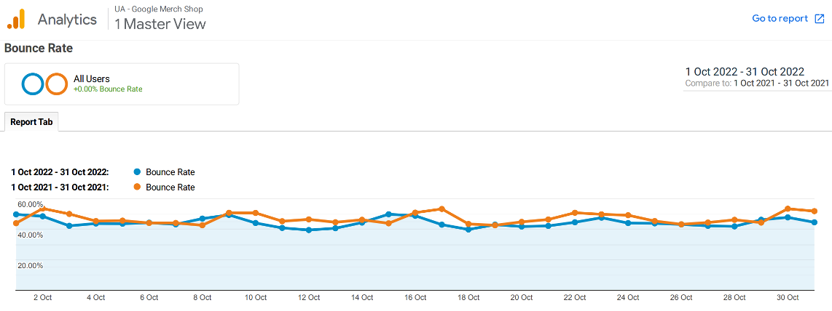

BOUNCE RATE
The overall bounce rate in October 2021 was 46.06% whereas it reduced to 43.62% in October 2022.

Slide 10
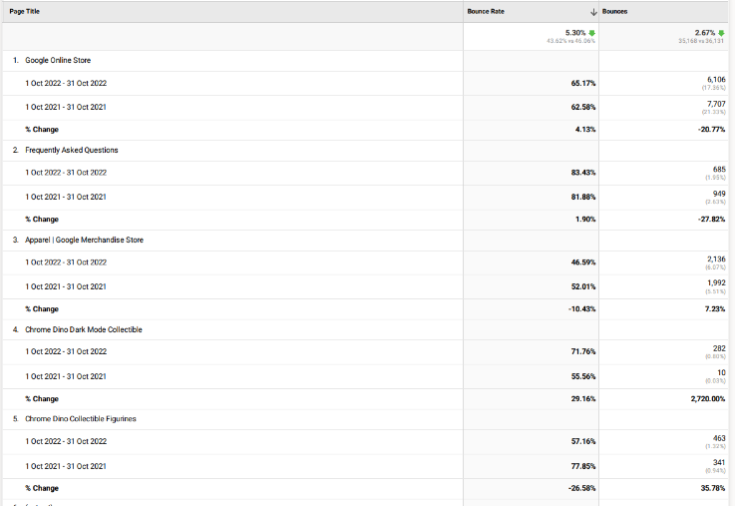
BOUNCE RATE
Google Online Store:
Bounce rate increased from 62.58% (Oct 2021) to 65.17% (Oct 2022).
Potential areas for improvement in user engagement and site content.
Apparel | Google Merchandise Store:
Bounce rate decreased from 52.01% to 46.59%.
Positive trend indicating improved engagement with apparel products.

Slide 11

Recommendations
Understand and Segment Your Audience
Optimize Landing Pages
Ensure that landing pages are relevant to the traffic sources sending users to the site.
Match the content of advertisements or search results to the content on the landing page.
Analyze user behavior through analytics tools to understand where users are dropping off.
Tailor content and design based on different audience segments.
Use A/B Testing
Provide Relevant Recommendation
Experiment with different page layouts, content formats, and CTAs to identify what resonates best with your audience.
Use personalized recommendations or related content sections to encourage users to explore more.

Slide 12
2. CONVERSION RATE
The conversion rate is a pivotal metric for assessing the success of an ecommerce business.
It measures the percentage of website visitors who complete a desired action, such as making a purchase.
This metric is crucial for evaluating the effectiveness of marketing strategies, optimizing the user experience, and driving revenue growth.
In short, the conversion rate is a key performance indicator that directly impacts a business's profitability and overall success.

Slide 13
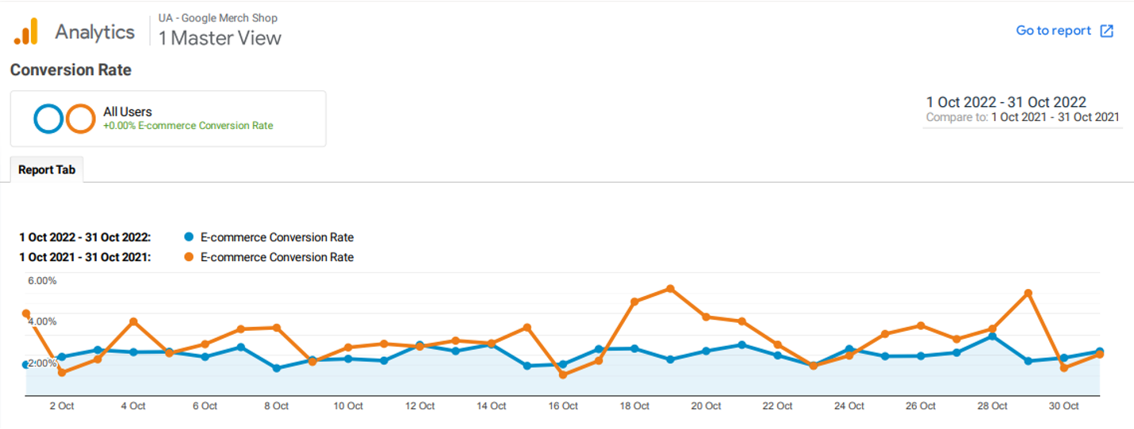
From the below its clear that the conversion rate has seen a magnificent dip of 30.70 % from October 2021 to October 2022.
During the initial half of the month, the conversion rate remains nearly consistent. However, in the latter half of October, there is a decline in 2022 as opposed to the same period in 2021.
CONVERSION RATE

Slide 14
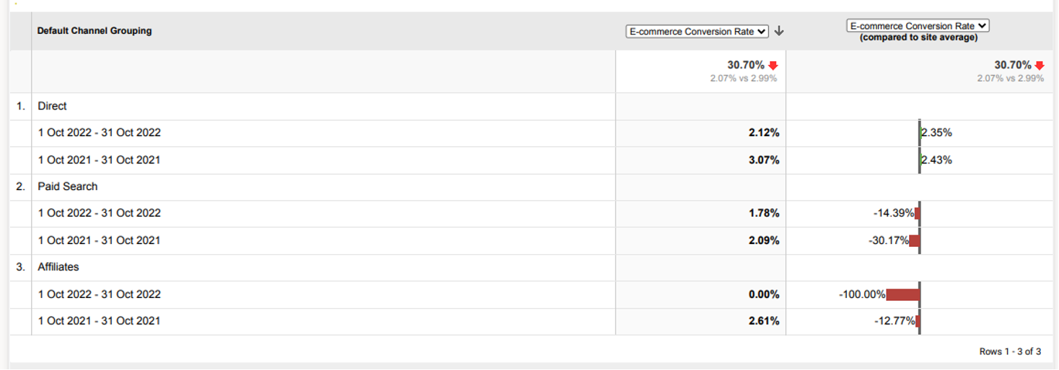
CONVERSION RATE
Overall conversion rate has decreased in all 3 channels going from 2021 to 2022.

Slide 15
Recommendations
Mobile Optimization
Personalization
Optimize the website for mobile users, as an increasing number of people browse and shop on mobile devices.
Ensure that all elements, including forms and CTAs, are mobile-friendly.
Use data to personalize content, recommendations, and offers based on user preferences and behavior.
Personalization can enhance the user experience and increase the likelihood of conversion.
Exit-Intent Pop-ups
Optimized Forms
Implement exit-intent pop-ups with special offers or discounts to capture visitors who are about to leave the site.
Use these pop-ups strategically to re-engage potential customers.
Streamline and optimize checkout or form-filling processes.
Minimize the number of form fields and use inline validation to reduce friction.

Slide 16
3. REVENUE
Revenue is a vital metric used to gauge a company's financial health and success.
It informs stakeholders about profitability, supports goal-setting, and aids in marketing ROI analysis.
Revenue is key for benchmarking, product performance evaluation, and making informed operational decisions.
In essence, it is a comprehensive indicator crucial for financial planning, industry comparison, and effective communication with investors and stakeholders.

Slide 17
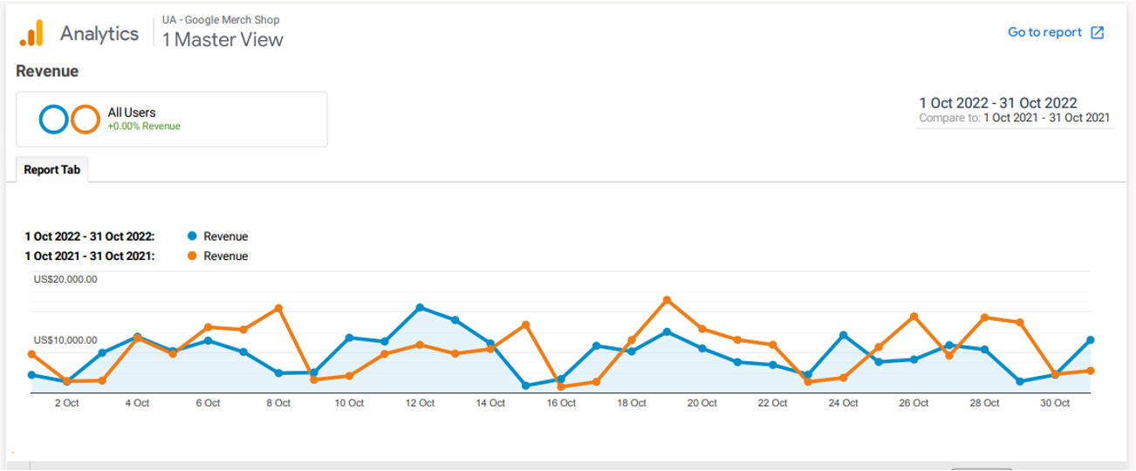
REVENUE
The data reveals a slight transformation in acquisition metrics from October 2021 to October 2022, indicating a 10.07% decrease in revenue.

Slide 18
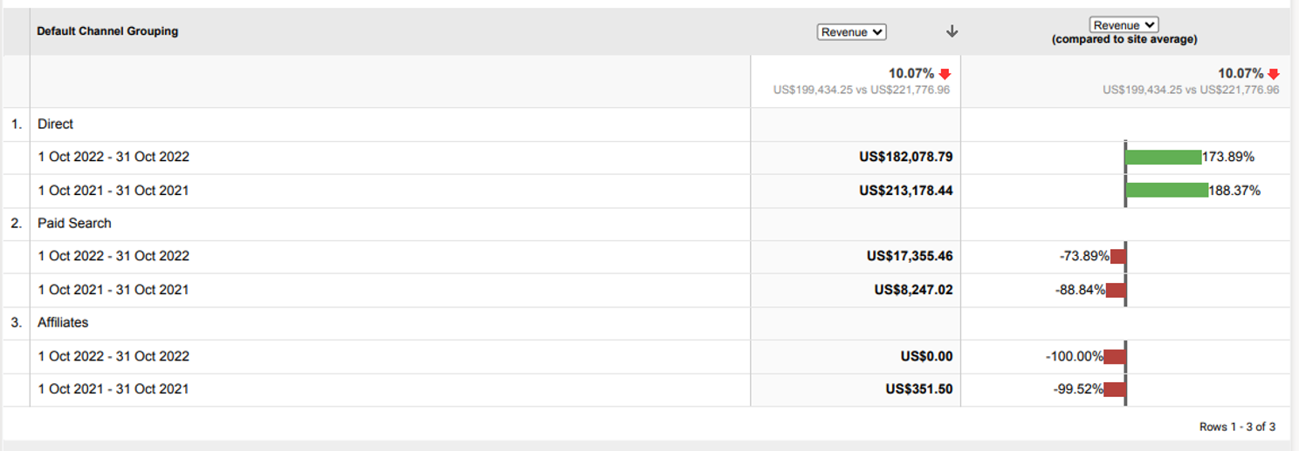
REVENUE
The revenue through direct channel has seen a drastic decrease from October 2021 to October 2022.
Paid search can see an increment whereas Affiliates has been decreased.

Slide 19
Recommendations
Implement Effective Pricing Strategies
Cross-Selling and Up-Selling
Ensure that landing pages are relevant to the traffic sources sending users to the site.
Match the content of advertisements or search results to the content on the landing page.
Implement cross-selling strategies to encourage customers to purchase related or complementary products.
Use up-selling techniques to promote higher-end or upgraded products.
Optimize SEO and Online Presence
Collaborate with Partners
Explore partnerships with other businesses to expand their reach or offer joint promotions.
Collaborate with influencers or affiliates to reach new audiences.
Improve search engine optimization (SEO) to enhance visibility on search engines.
Leverage online platforms and marketplaces to reach new customers.

Slide 20




